Slide 1

How do Organisms
Reproduce?
The importance of variation

Slide 2
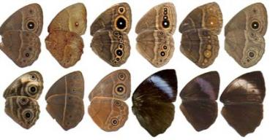
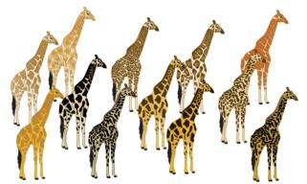

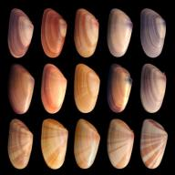
The importance of variation

Slide 3
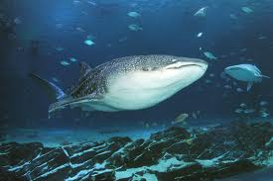
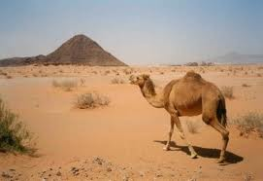
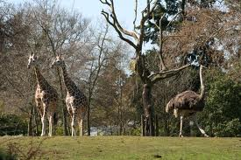
The importance of variation
Populations of organisms live in well-defined places - Niches

Slide 4
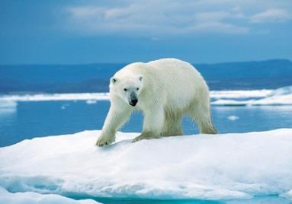
The importance of variation
Populations of organisms live in well define places - Niches
Their body design allows them to use that particular niche.
The polar bear is well adapted to its Arctic environment as their white fur helps them blend in with the snow and ice and has a layer of fat under its skin which helps it stay warm

Slide 5

The importance of variation
However, niches can change because of reasons beyond the control of organisms.

Slide 6

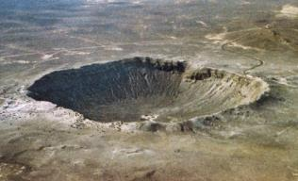
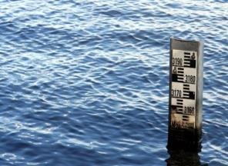
The importance of variation
Temperatures can go up and down
or meteorite hits.
water levels can vary

Slide 7

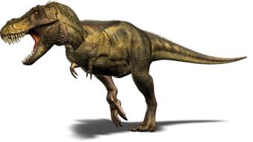
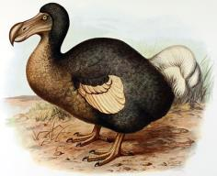
The importance of variation
If this is drastically altered – population will be wiped out.

Slide 8
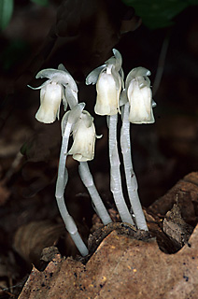
The importance of variation
For eg. The Indian Pipe Plant earlier was photosynthetic due to the presence of chlorophyll. During the course of evolution, it lost its chlorophyll and became saprophytic. This variation in the plant mode of nutrition has helped it to survive till date.
However if some variations are present population can survive.

Slide 9
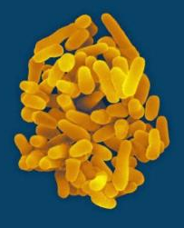
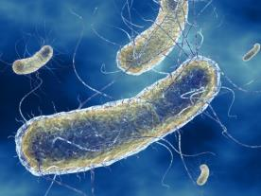
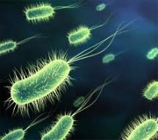

The importance of variation
E.g. if there were a population of bacteria living in temperate water,
and if the water temperature was increased by global warming, most of them would die.
But few variants resistant to heat would survive and grow further

Slide 10

Variation is thus useful for the survival of species over time.

Slide 11
Thank You

